Slide 1
Introduction to OSPF
201595103 왕요
201595101 왕문정

Slide 2
OSPF
Open Shortest Path First
Link state or SPF technology
Developed by OSPF working group of IETF (RFC 1247)
OSPFv2 standard described in RFC2328
Designed for:
TCP/IP environment
Fast convergence
Variable-length subnet masks
Discontiguous subnets
Incremental updates
Route authentication
Runs on IP, Protocol 89

Slide 3
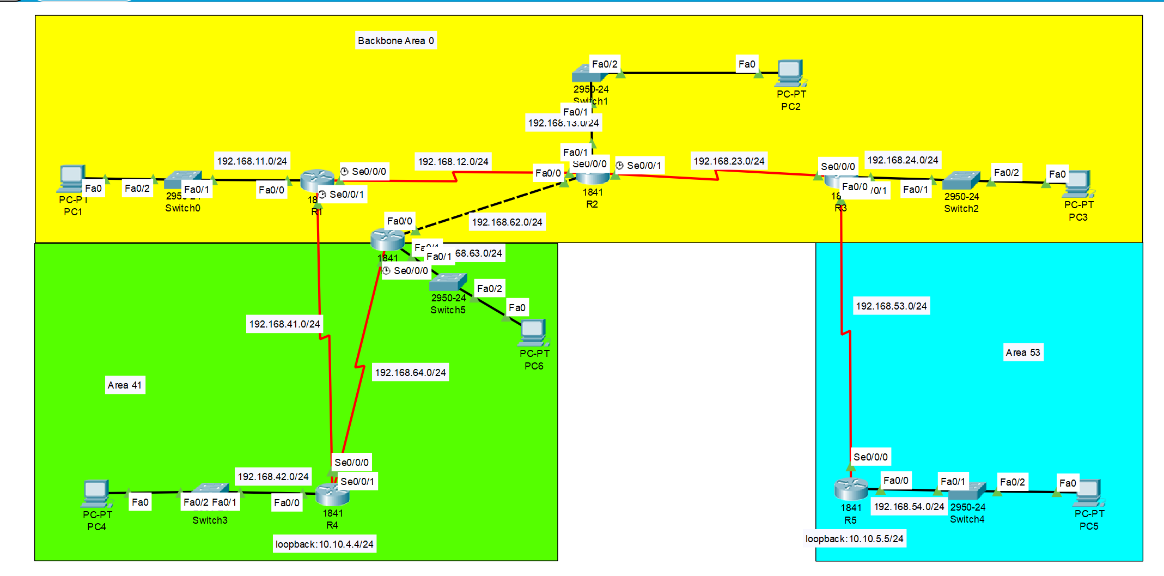
Multi Area
AREA 41
AREA 53

Slide 4
IP 주소
R1
Interface | IP Address | Subnet Mask
Se0/0/0 | 192.168.12.1 | 255.255.255.0
Se0/0/1 | 192.168.41.1 | 255.255.255.0
loopback0 | 10.10.1.1 | 255.255.255.0
R2
Interface | IP Address | Subnet Mask
Se0/0/0 | 192.168.12.2 | 255.255.255.0
Se0/0/1 | 192.168.23.1 | 255.255.255.0
Fa0/0 | 192.168.62.1 | 255.255.255.0
loopback0 | 10.10.2.2 | 255.255.255.0

Slide 5
R3
Interface | IP Address | Subnet Mask
Se0/0/0 | 192.168.23.2 | 255.255.255.0
Se0/0/1 | 192.168.53.1 | 255.255.255.0
loopback0 | 10.10.3.3 | 255.255.255.0
R4
Interface | IP Address | Subnet Mask
Se0/0/1 | 192.168.64.2 | 255.255.255.0
Se0/0/0 | 192.168.41.2 | 255.255.255.0
loopback0 | 10.10.4.4 | 255.255.255.0

Slide 6
R5
Interface | IP Address | Subnet Mask
Se0/0/0 | 192.168.53.2 | 255.255.255.0
loopback0 | 10.10.5.5 | 255.255.255.0
R6
Interface | IP Address | Subnet Mask
Se0/0/0 | 192.168.64.1 | 255.255.255.0
Fa0/0 | 192.168.62.2 | 255.255.255.0
loopback0 | 10.10.6.6 | 255.255.255.0

Slide 7
Divide OSPF area
Area name | Area type | Device
Area 0 | Backbone Area | R1 : Se0/0/0
Area 0 | Backbone Area | R2
Area 0 | Backbone Area | R3 : Se0/0/0
Area 0 | Backbone Area | R6 : Fa0/0
Area 53 | Common Area | R5
Area 53 | Common Area | R3 : Se0/0/1
Area 41 | Special Area : NSSA | R1 : Se0/0/1
Area 41 | Special Area : NSSA | R6 : Se0/0/0
Area 41 | Special Area : NSSA | R4

Slide 8
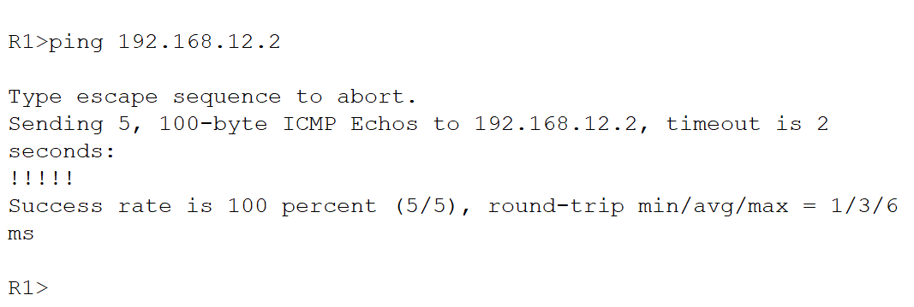
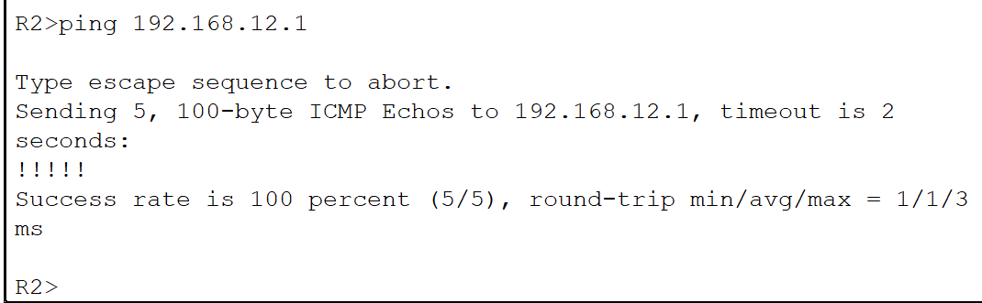
상호 운용성 확인
AR1->AR2
AR2->AR1

Slide 9
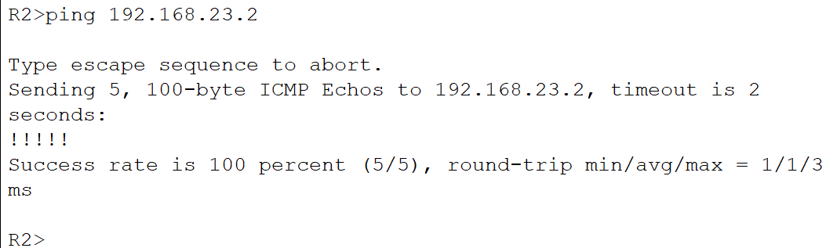
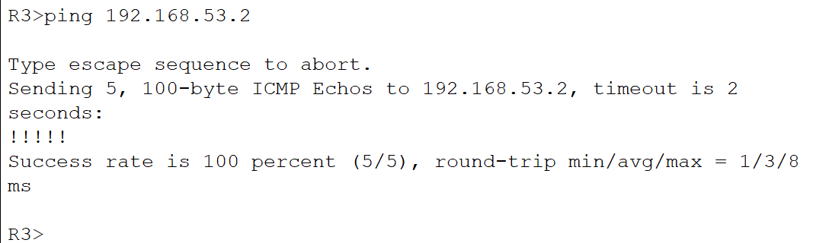
AR2->AR3
AR3->AR5

Slide 10
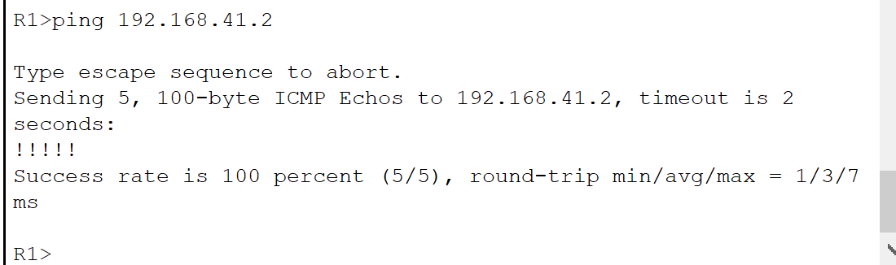
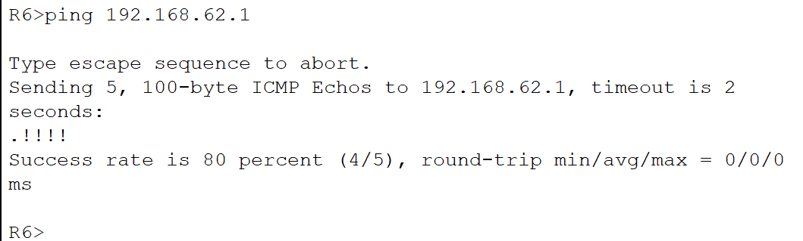
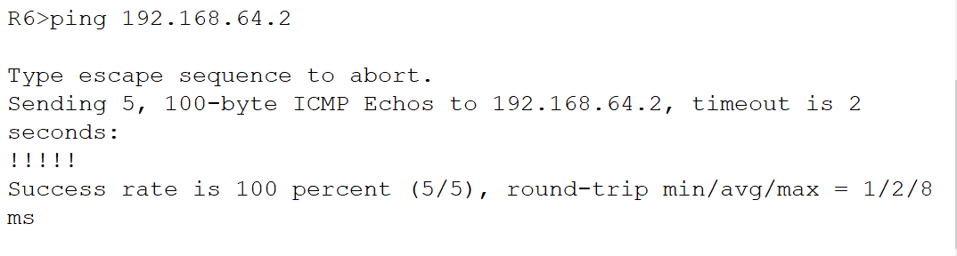
AR1->AR4
AR6->AR2
AR6->AR4

Slide 11
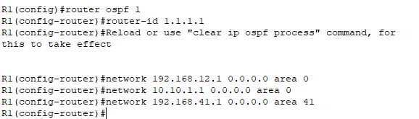
OSPF 영역 분리
AR1

Slide 12
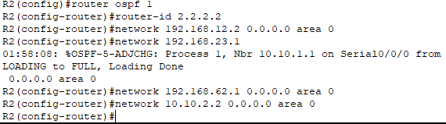
OSPF 영역 분리
AR2

Slide 13
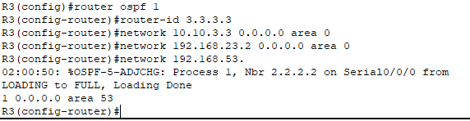
OSPF 영역 분리
AR3

Slide 14
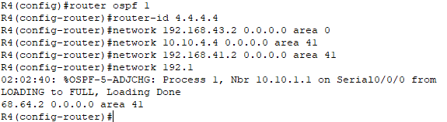
OSPF 영역 분리
AR4

Slide 15
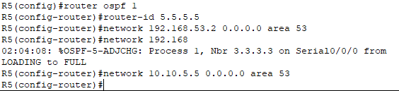
OSPF 영역 분리
AR5

Slide 16
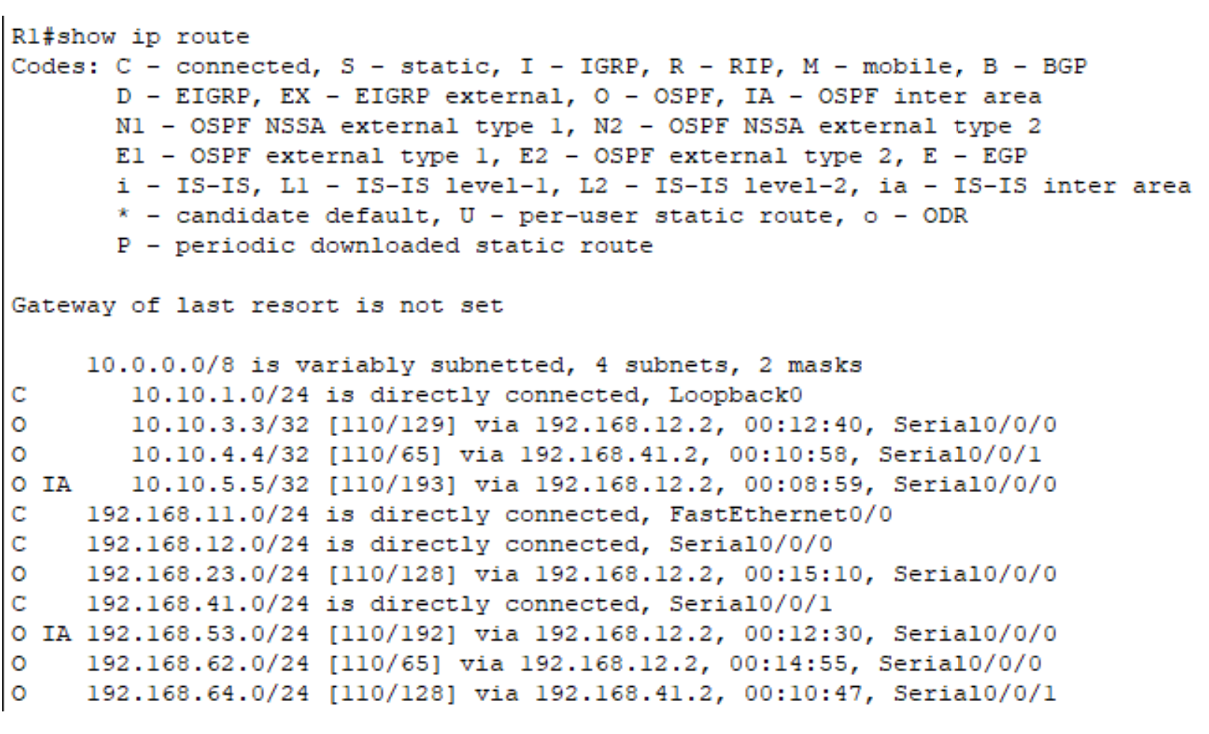

Slide 17
Introduction to OSPF
감사합니다!

